Slide 1
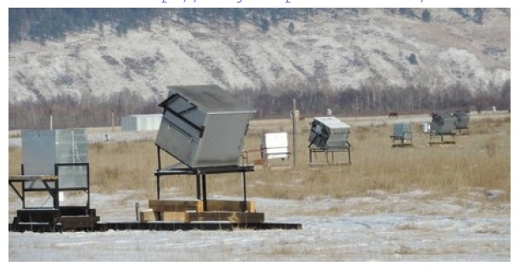
The TAIGA experiment for gamma astronomy above 30 TeV and first results.
L.G. Sveshnikova et al .
Skobeltsyn Institute of Moscow State University
TAIGA –HiSCORE :
High Sensitivity Cosmic Origin Explorer
In Tunka Valley near lake Baikal

Slide 2
Outline
Introduction
Preliminary methodical analysis of the first experimental data of TAIGA-HiSCORE in commissioning stage ( season 2015-2016 )
Method of reconstruction
Estimation of energy threshold and effective energy
Angular and core position resolution
The sample of events directed to the Crab nebula
Expectations from MC.

Slide 3
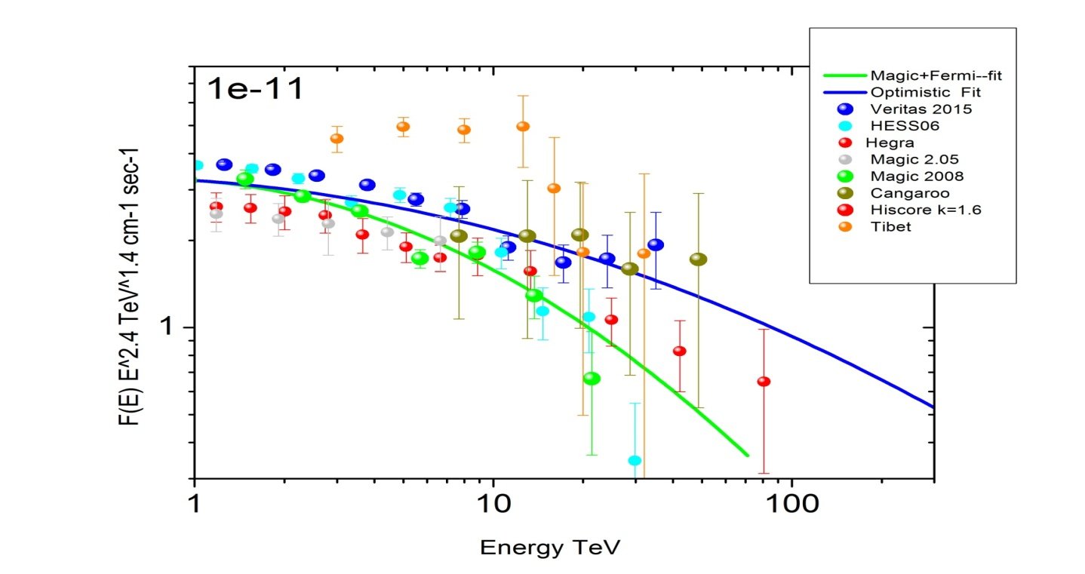
Sources
Tunka valley latitude 51.8 degrees
Tycho SNR Ra=6.34, dec=64, Cas A Ra=351, Dec=59, СТА _1 Ra=1.5 ,dec=73
Crab Nebular Ra=83.63, dec=22.
Up to now only in 10 sources the gamma rays with energy more than 10 TeV are detected and no one have been found with energy more than 100 ТэВ (candidate to PeVatron).
30 TeV
Crab nebula: “standard candle” in gamma-astronomy. But in the region >30 TeV the uncertainty is very large, and Crab is a subject to study.
Optimistic
Pessimistic
Notes:
The task of my report is to perform the preliminary analysis of the first experimental data of TAIGA-HiSCORE with tilting to south stations in commissioning season 2015-2016 and to answer can we see some signal now, do we see.

Slide 4
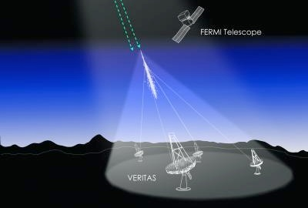
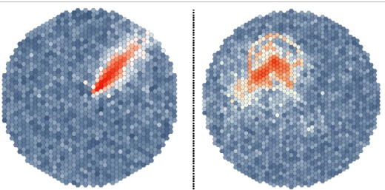
Method of Imaging Atmospheric Cherenkov Telescopes .
The IACT technique was developed and optimized for energies around 1 TeV.
A typical design consists a system of Cherenkov telescopes with a mirror, a camera
with a field of view of the order of 4 degrees. To move to higher energy it requires a
larger effective area and a large number of telescopes (CTA) .
From image parameters:
HEGRA
VERITAS
MAGIC
HESS
….CTA
to
1)Direction and core
position by stereo systems,
2)Energy by photons,
3) Very effective background
rejection

Slide 5
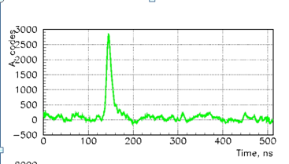
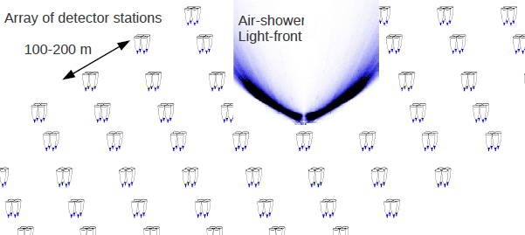
Non IACT method (timing array)
Non IACT technique was developed in Tunka-25 and 133 array for cosmic rays
detection and was optimized for PeV -100 PeV energy. To move to sub
TeV region high sensitive detectors were developed and in 2014-2015
exposure of first 9 stations confirmed the possibility to reach threshold to 200 TeV.
Ti, Qi,Ami
Themistocle
AIROBICC
HiSCORE
….TAIGA
1)The directions:
– by the time delay
2The core position: by the
lateral distribution
of cherenkov photons
3) Type of particles
Not so effective as in IACT

Slide 6
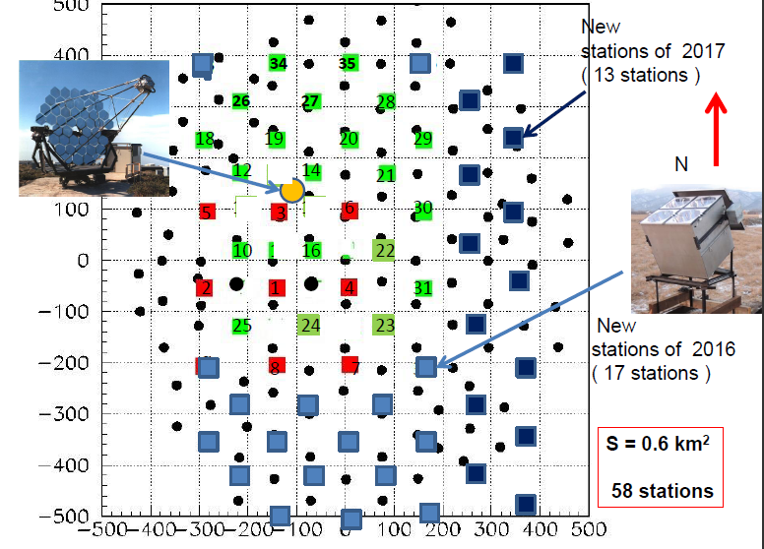
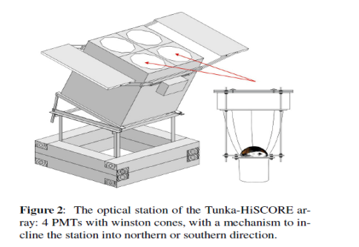
Prototype TAIGA 2017-2018 HiSCORE+IACT (0.6 km2+IACT)
This work:
HISCORE 2015-2016:
28 detectors ,
106 m distance,
0.25 km2
All stations are tilting to the South ( 25 deg)

Slide 7
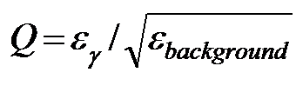
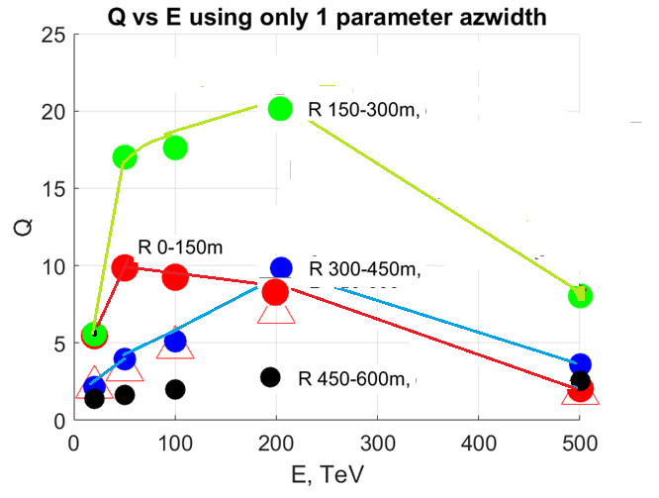
Primary gamma ray selection technique in the joint operation of Imaging Atmospheric Cherenkov Telescopes (IACTs) and wide angle Cherenkov timing detectors (see poster E. Postnikov et al)

Slide 8
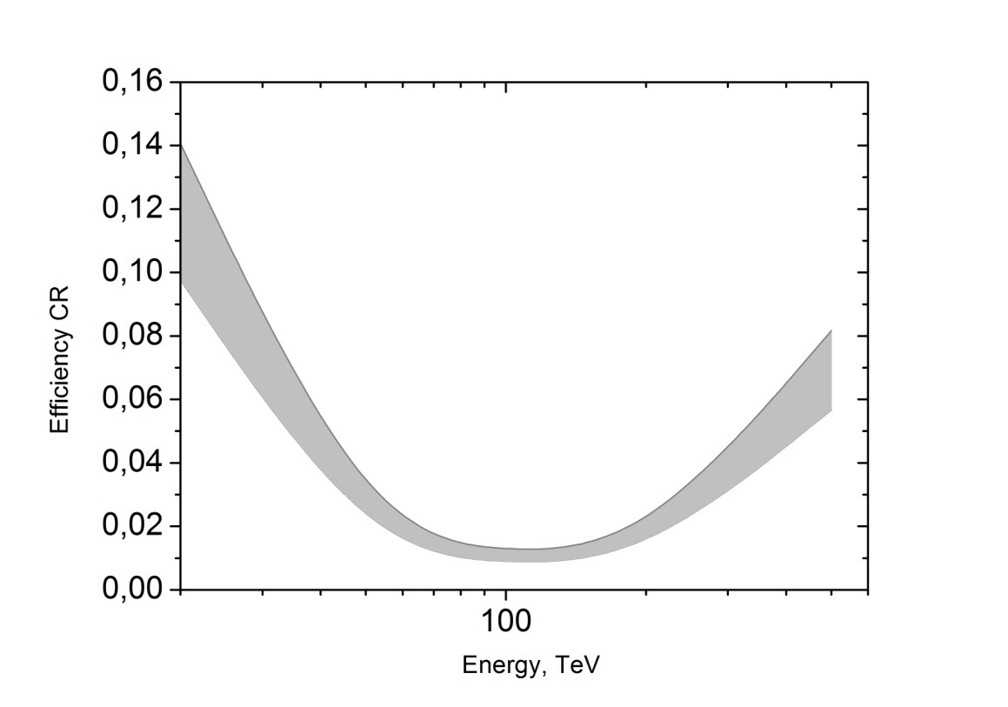
Primary gamma ray selection technique in the joint operation of Imaging Atmospheric Cherenkov Telescopes (IACTs) and wide angle Cherenkov timing detectors (see poster E. Postnikov et al)

Slide 9
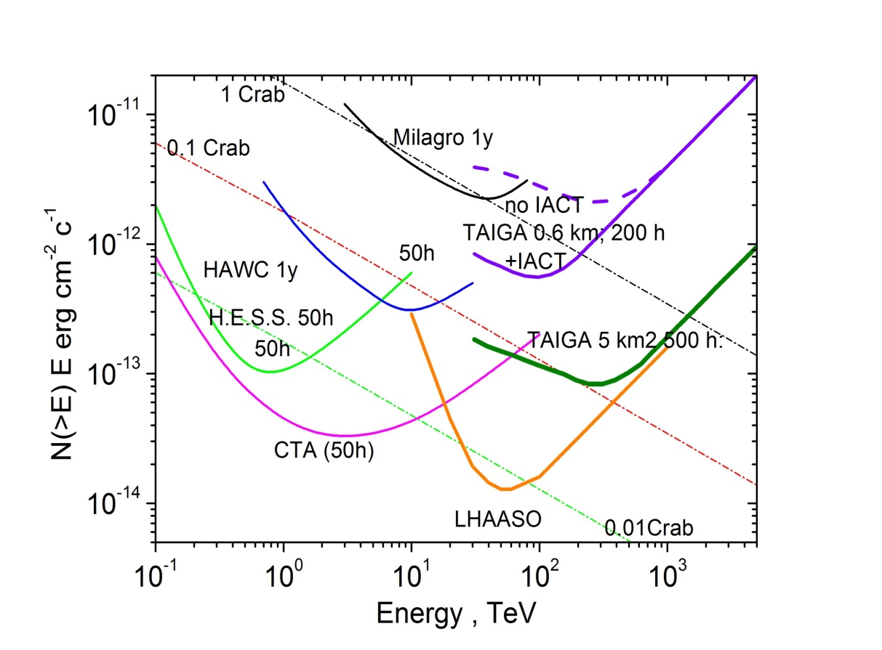
Integral sensitivity of the prototype of TAIGA.
The most important factors
for the sensitivity to local sources
Linear dependence:
On accuracy of angular
resolution : Psi – the angular
between true and measured
directions
Q factor of CR background
Suppression
As square root from
ST factor at E<Emin
linear at E>Emin
ϕ(>E) = 5×ETeV×1.6× dθ × Qf⁻¹ √(F_{cr}(E) × π cm⁻² sec⁻¹ erg (ng=5 √Nbg)
(√ S_{gef}(E) ×T)
ϕ(>E) = ETeV×1.6 × 10/(S×T×δNg^{on} ) NgThr>=10

Slide 10
Method of reconstruction of shower parameters: core positions, angles, energy (see report of V. Prosin on Friday)
1)Selection of showers with 4 hit detectors (Ndet≥5 for Crab)
2)Rough estimation of θ and ϕ by time delay in every station
with plane approximation of shower front
3)Core position X0,Y0 estimation by amplitudes in different detectors.
4)Re-estimation of θ and ϕ with known X0,Y0, fitting time front by cone –like function
5)Approximation of Qi(Ri) by ’Tunka’ fitting function and estimation of Q200
6) Transition from Q200 to Energy
7)Calculation of right ascension (Ra)and declination (Dec) of showers
8) Analysis of the sample in cone <3 degrees and <0.4 degrees
in Crab direction. Maps Ra-Dec, background calculation

Slide 11
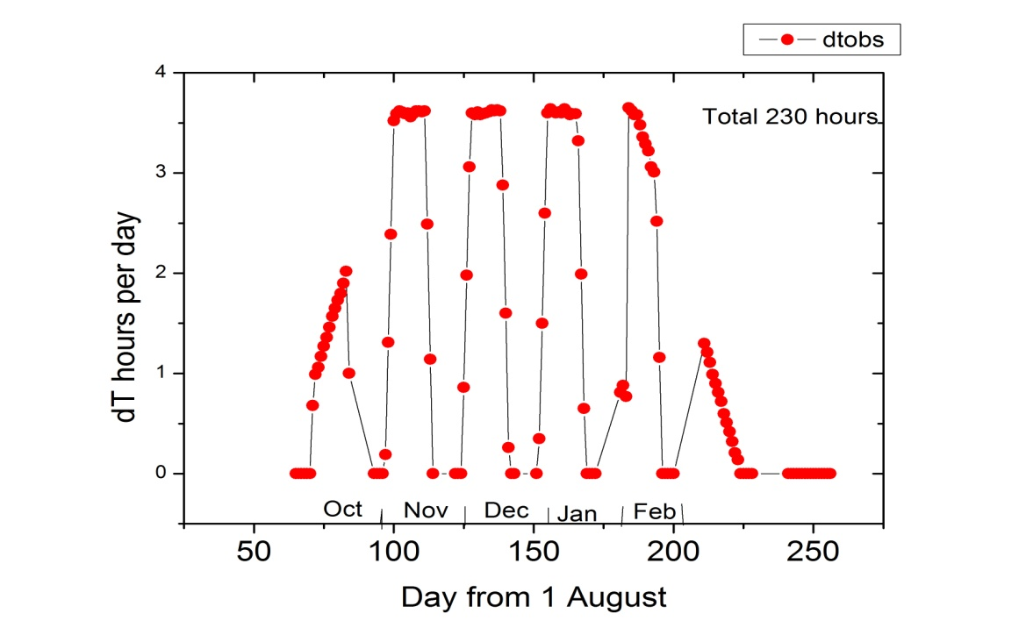
Time of observation of Crab Nebula per day at the Tunka valley with tilting stations.
The total expected time of Crab observation for tilting stations during the year in moonless days ~ 230часов,
From many years observation it is known that cloudless good weather ~ ½ of this time.
3) Real time of observation ~ 54 hours

Slide 12
Statistics
In total there were selected ~ 5.0 millions showers with Ndet≥4 with the reconstructed core positions inside the ellipse with axles 300 and 225 m during 24 days when showers with Crab direction were observed.
The sample of showers within the cone Psi <3 degrees and Psi < 0.4 degrees
in the Crab direction (Ra=83.63, declination=22.01)
 | all days | Days with Crab obs. | Statistics <3 deg | Statistics <1 deg | Statistic <0.4 deg | Full time hr | Crab Time hr
Total statistic |  |  | ~29000 | ~3280 | ~550
Sample Ndet≥5 E<200 TeV at the area 0.25 km2 | 35 days | 24 days | 10287 | 1144 | 183 | 230 hours | 54 hours

Slide 13
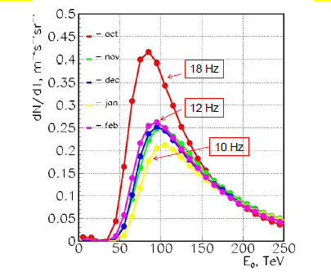
Estimation of energy threshold and peak energy for CR from the counting rate of 4 hit detectors.
Experimental counting rates:
16-18 in October
9-11 in February
Different threshold from
October to February
Eeff
EefE
Changing of effective energy of CR from month to month

Slide 14
Energy threshold depends on Qth

Slide 15
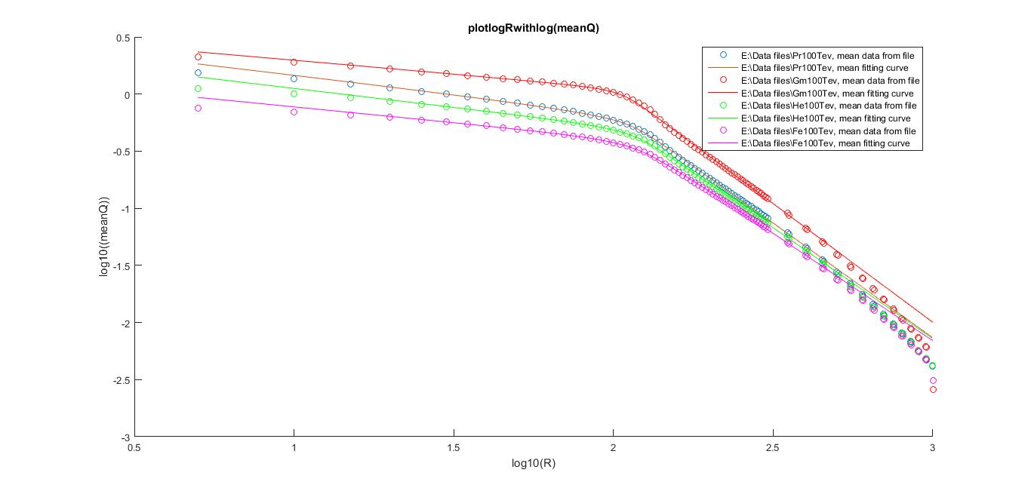
Mean lateral distribution functions for primary gamma protons, He, Fe with fixed energy 100 TeV
Log Q ph/cm2
gamma
Pr
He
Fe
Q200
Log Rm
Reconstructed effective energy for gamma is 1.7 time smaller than for Cosmic rays

Slide 16
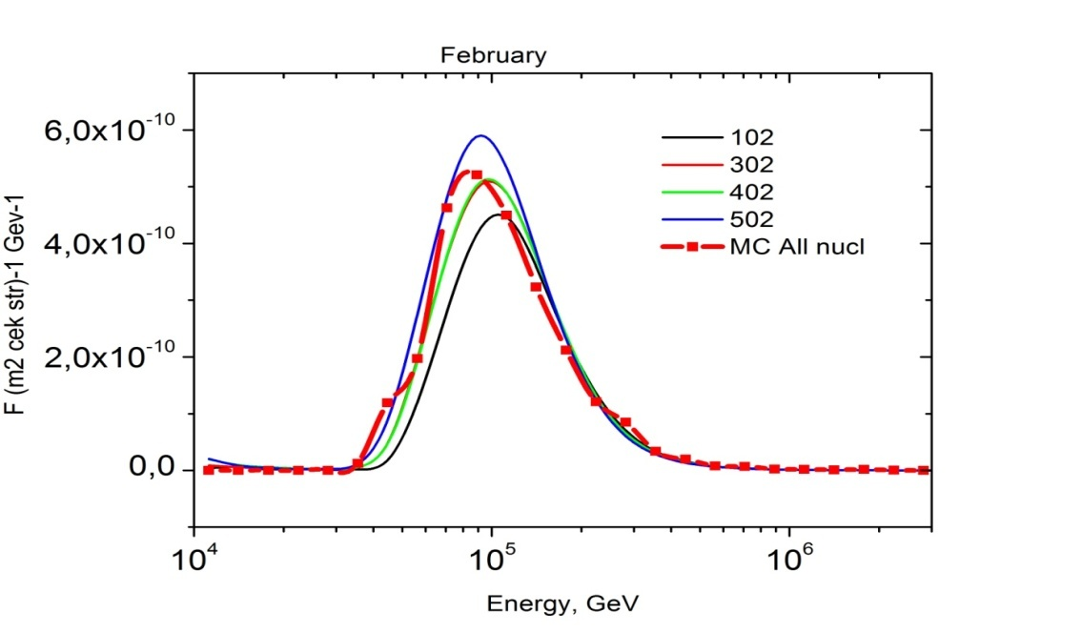
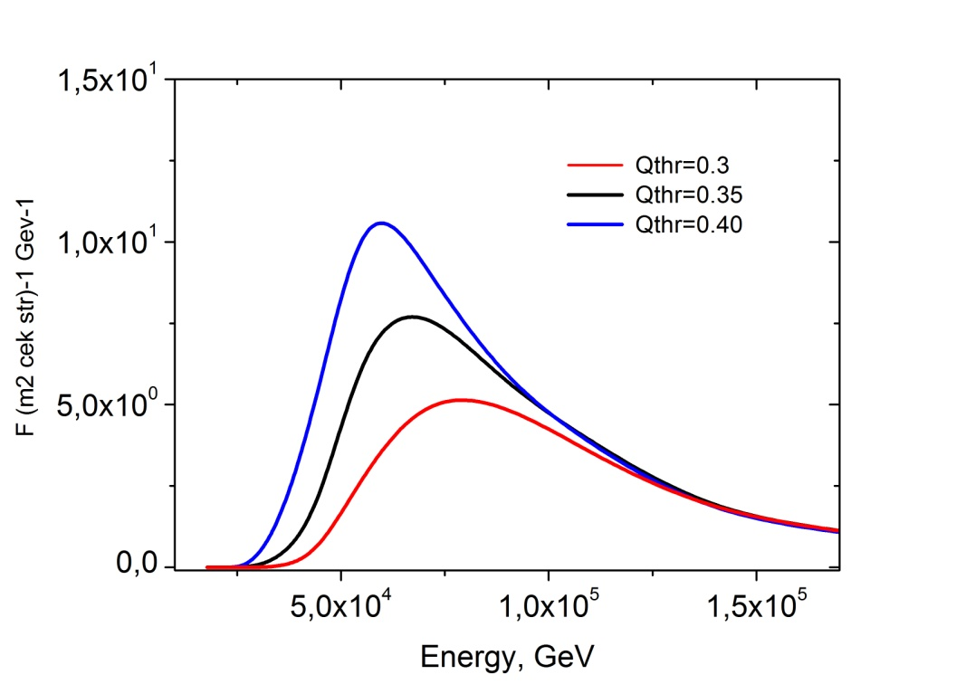
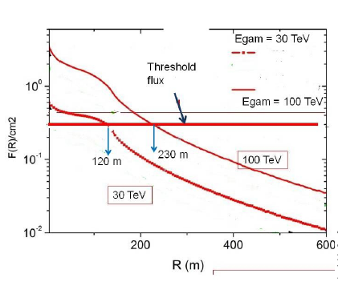
MC- simulation of counting 4-stations rates at different threshold of Cherenkov photon density per cm2
Qth Ch.ph/cm2 | Rates Hz Pr-He only | Rates Pr-He-C-Fe | Eef for gamma
0.30 | 20 Hz | 17 Hz | ~55 TeV
0.35 | 17 Hz | 14 Hz | ~65 TeV
0.40 | 14 Hz | 11.6 Hz | ~75 TeV
MC sumulation for all CR
CR February
Eeff For gamma

Slide 17
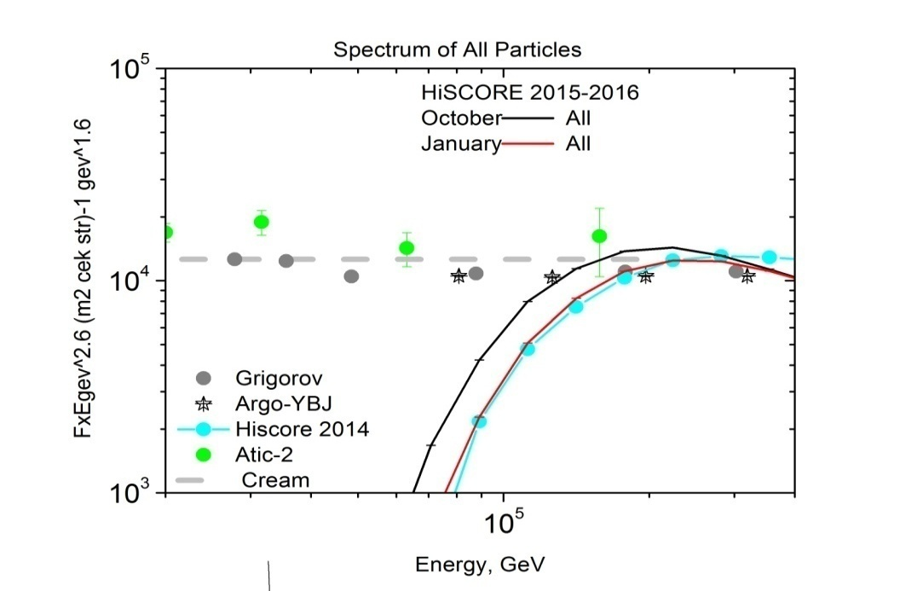
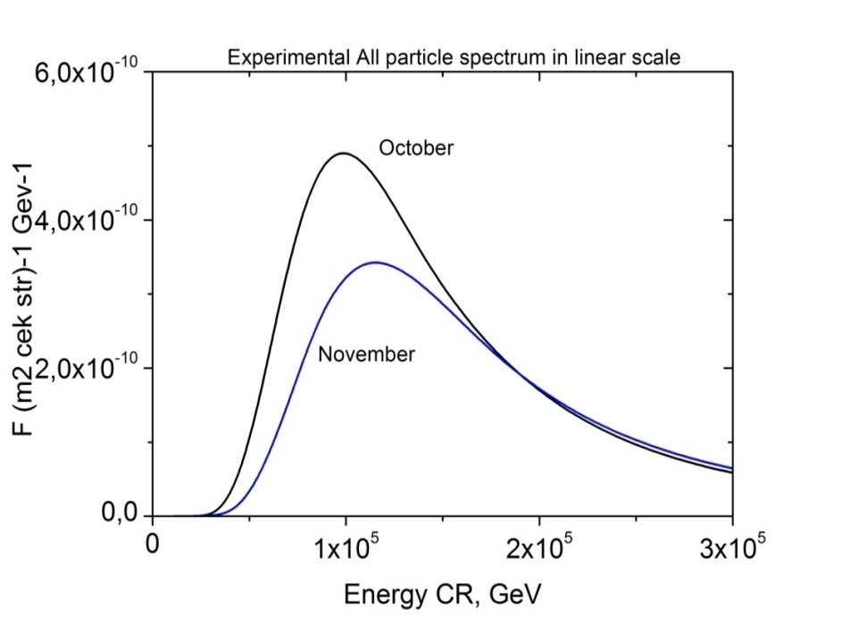
Comparison of CR spectra in the threshold region with direct measurements, and ARGO JBY and HiSCORE 2014-2015, estimation of Ethr for gamma rays.
Спектр в
Eeff
Spectrum
In linear scale
HiScore 2015-2016
Expected effective energy (peak energy) for Gamma rays: 50- 70 TeV

Slide 18
MC – simulations: arrival and core position resolution for gamma rays with zenith angle (29-38 degrees) in dependence on the number of hit detectors
Anglular resolution
Core position resolution
Gam= ~0.40+- 0.5 at 5 detectors dR~ 50+-14 m at 5 detectors
Peak energy 50 -70 TeV roughly corresponds to 5-7 hit detectors

Slide 19
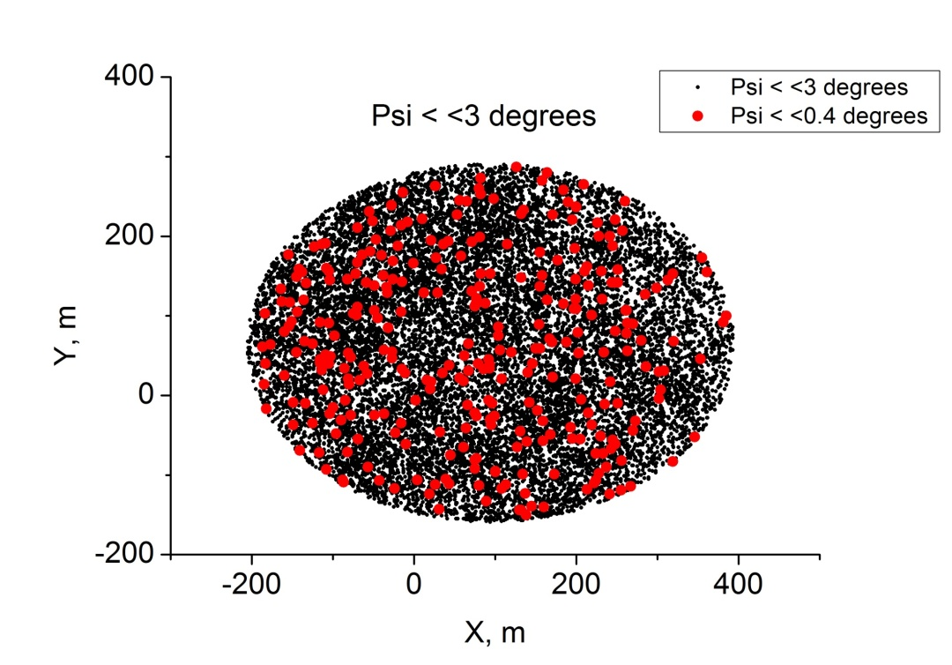
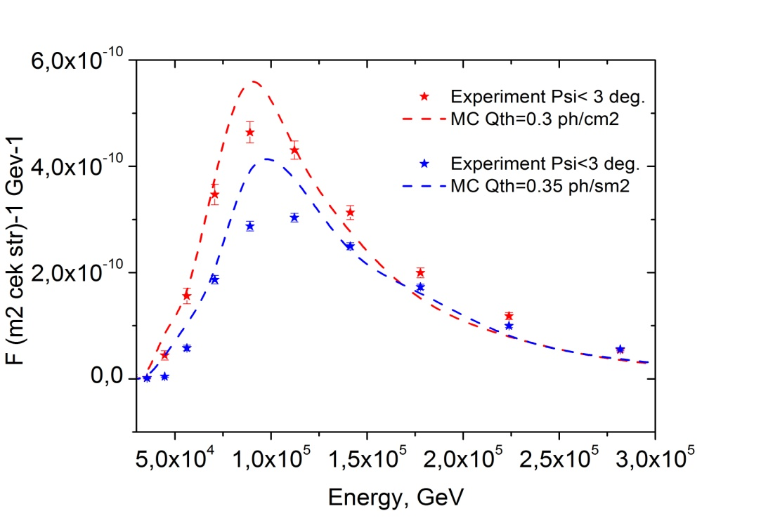
Reconstructed X, Y core position and CR energy spectra for the sample Psi <3 degrees
We reproduce the peak energy,
but distribution of Qth from day to day
makes experimental distribution
slightly wider
October
January
Выборки соответствуют расчетам
по всем параметрам

Slide 20
Expectation of Crab signal excess for the array 0.25 km2 for real time observation for different thresholds
What excess in sigma we can get depends on the threshold energy
and approximation of Crab spectrum:
we can reach 4 sigma, If Eth~25 TeV and only ~ 2 sigma if we have ~40-50 TeV
Ethr 40 50. 63. 80 100.0 125. 158.5
Optimistic 28.3 18.7 13.1 9.7 7.4 5.7 4.5
Veritas 22.6 14.3 9.8 7.0 5.2 4.0 3.1
Hegra 27.0 18.5 13.4 10.1 7.9 6.3 5.0
Magic 11.7 7.1 4.6 3.2 2.3 1.7 1.3

Slide 21
Examples of the map Ra-Dec 3×3 degrees with the sell 0.3 × 0.3 degrees for events with E<100 TeV. (Ra =83.65, Dec=22.01)
Preliminary !
E<80 TeV.
Background 23, red - 36
Excess ~13 events
E<100 TeV.
Background ~ 27.5/cell –light blue,
Excess - yellow ~40/cell
Excess ~13 events

Slide 22
Conclusions
During the commissioning stage 2015-2016 we have obtained 10 millions events during 230 hours and 35 days.
Crab observation has been possible during 24 days and 56 hours, ~ 30000 events from Crab direction within 3 degrees, 3200 events within <1 degree and 550 at < 0.4 degrees .
We have analyzed the first sample and estimate the effective energy for gamma rays as 50-70 TeV .
The comparison of data with MC simulation (rates, effective energies, multiplicity, core position distribution) shows good agreement.
We analyzed Ra –Dec maps in direction to Crab and see
excess around 10 - 15 events, that depends on the applied method of reconstruction , energy and corresponds to the expectation.
Tasks for the next season: Improvement of reconstruction method for low-E nergy ( core position, direction, energy) optimization of cut-selection procedure. For next season: Add the 4-th PMTs in all stations On-line checking the array counting rate and correction of trigger threshold

Slide 23
Thank you for attension

Slide 24
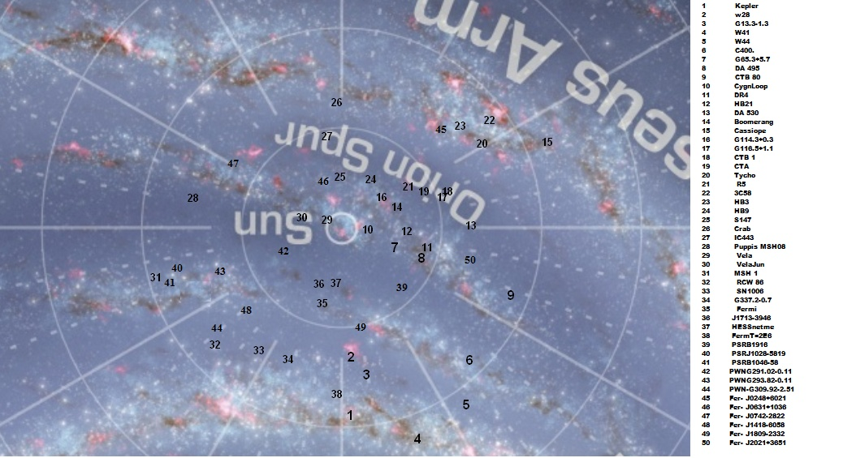

Slide 25
Crab-signal: array 0.27 km2, dr=106 m; T=100 hours

Slide 26
Prediction for Tycho: 3km2,200 hr

Slide 27
Arrival and core position resolution for gammas tet=0-25 degrees (Tycho)
Threashold 30-40 TeV
Gam= ~0.24+- 0.5 at 5 detectors dR~ 22+-14 m at 5 detectors

