Slide 1
REGISTRATION OF RADIO-EMISSION FROM EXTENSIVE AIR SHOWERS AT THE TIEN SHAN EAS INSTALLATION (3340 M A.S.L.) Boos E., Haungs A., Sadykov T., Salihov N., Shepetov A., Tautayev Y., Vildanova L., Zhukov V.,

Slide 2
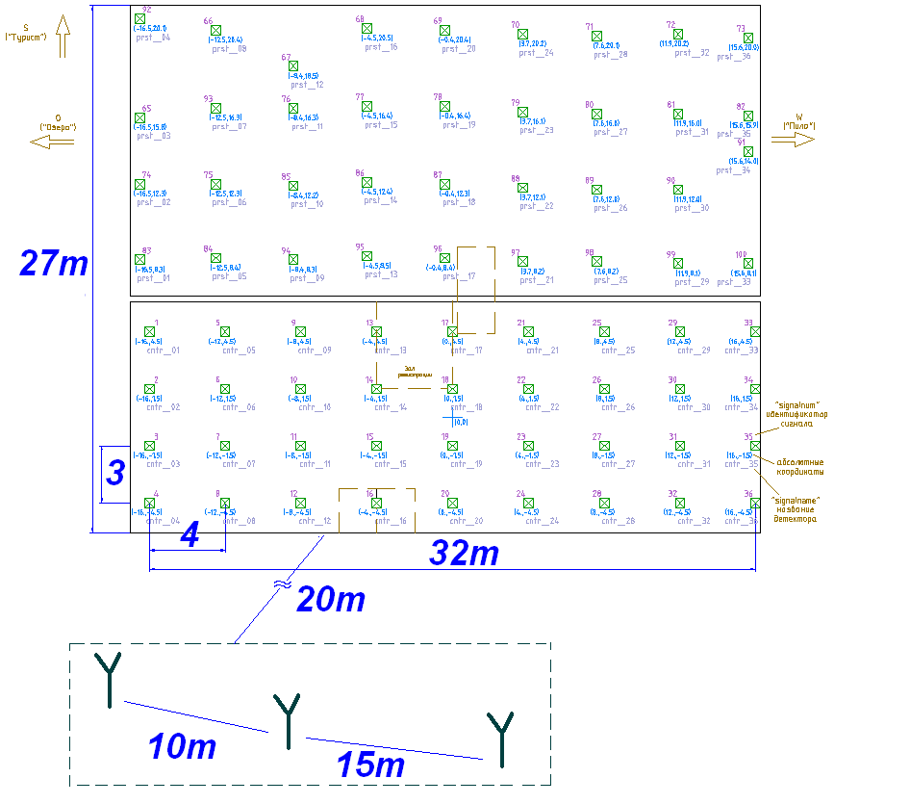
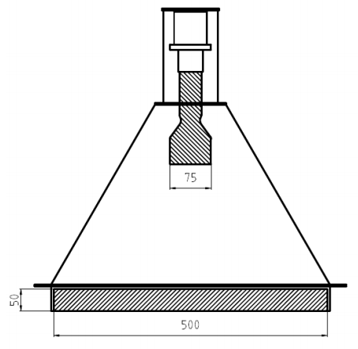
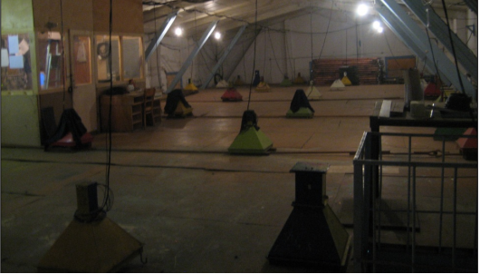
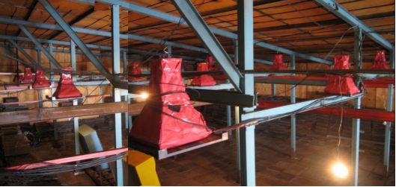
SHOWER INSTALLATION OF THE TIEN SHAN MOUNTAIN COSMIC RAY STATION

Slide 3
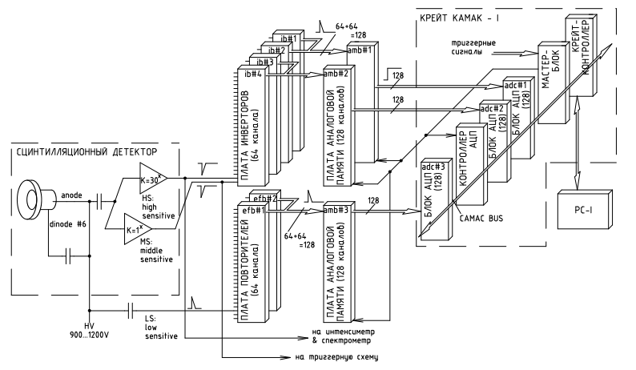
THE EAS REGISTRATION SYSTEM
three amplitude diapasons in each detector channel ;
overall dynamic range of amplitude conversion up to 10⁶ with the use of all three amplitude ranges;
100% registration efficiency of EAS with >3*10¹⁴ eV and the axis within scintillation carpet.

Slide 4
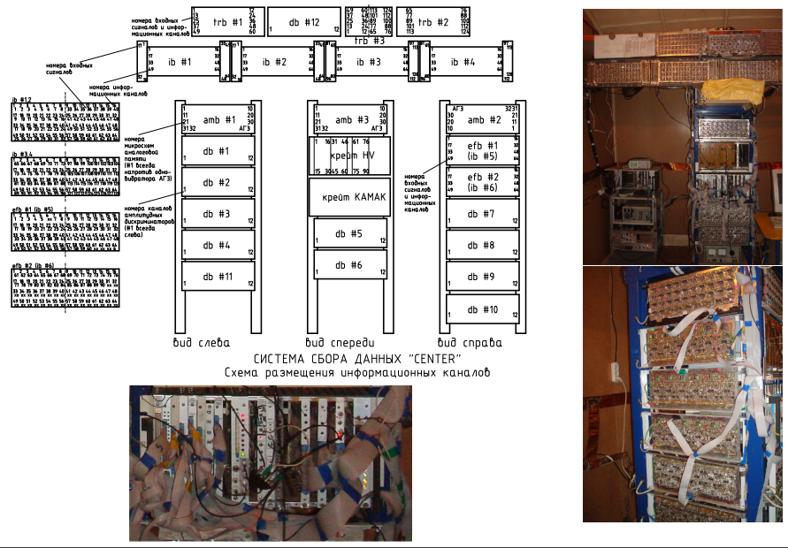
THE EAS REGISTRATION SYSTEM

Slide 5
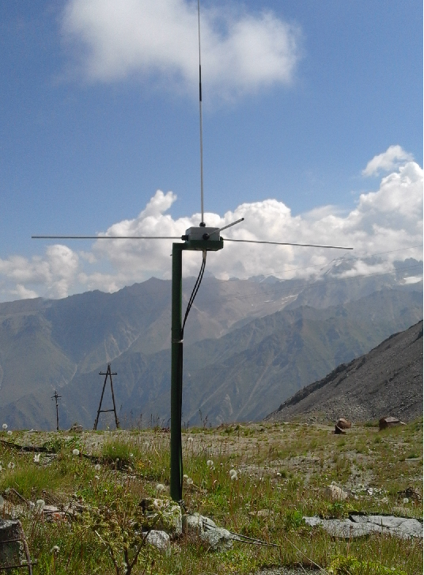
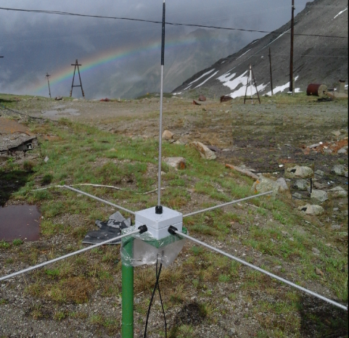
THE ANTENNA SET FOR REGISTRATION OF EAS RADIO-EMISSION
frequency range
25-75MHz ;
3 registration points ;
2 horizontal and 1 vertical polarizations in each point.

Slide 6
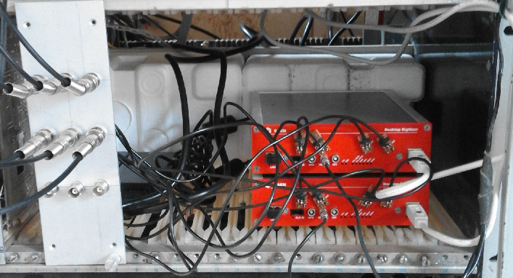
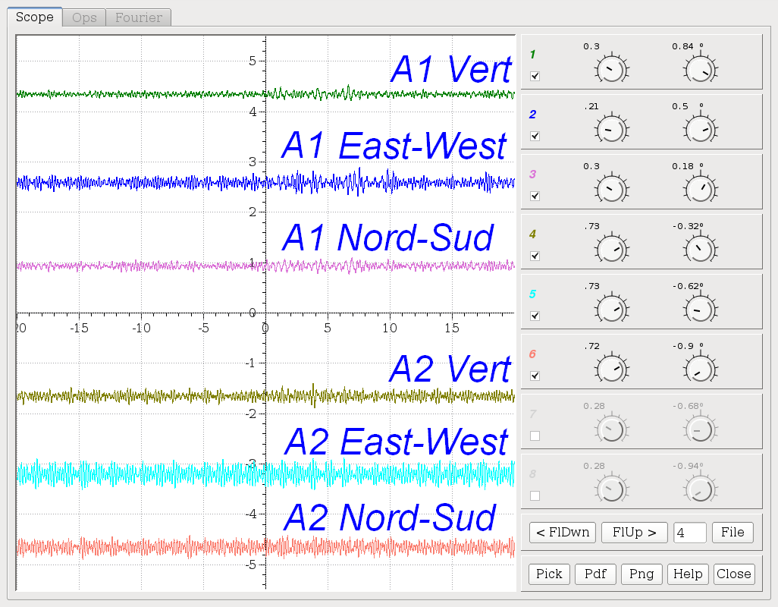
RADIO-SIGNAL REGISTRATION SYSTEM
built on two DT5720 type fast ADC modules of CAEN production ;
12 bit conversion;
synchronized with EAS trigger from shower installation ;
8 informational channels ;
10 000 time intervals ;
4ns digitizing period.

Slide 7
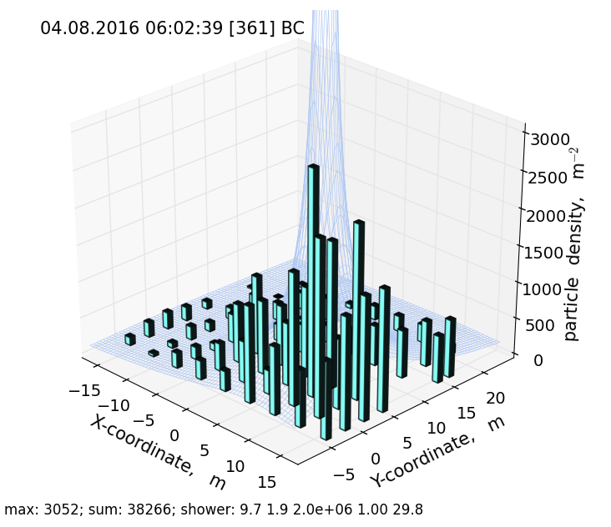
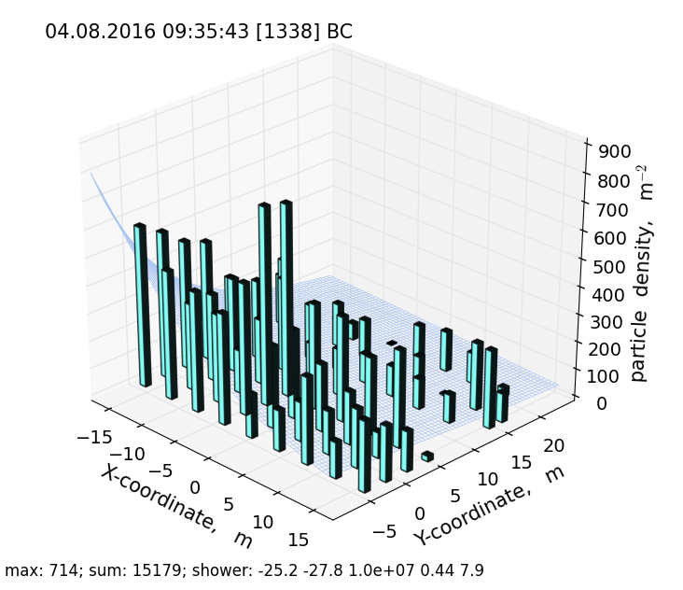
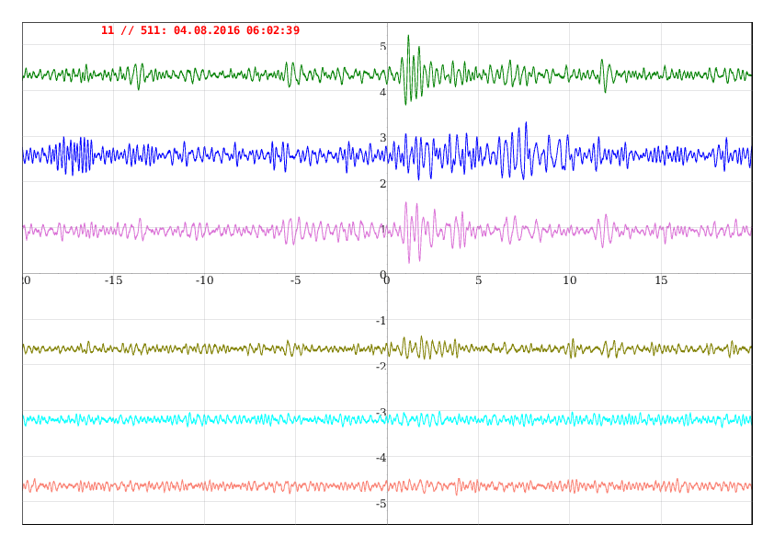
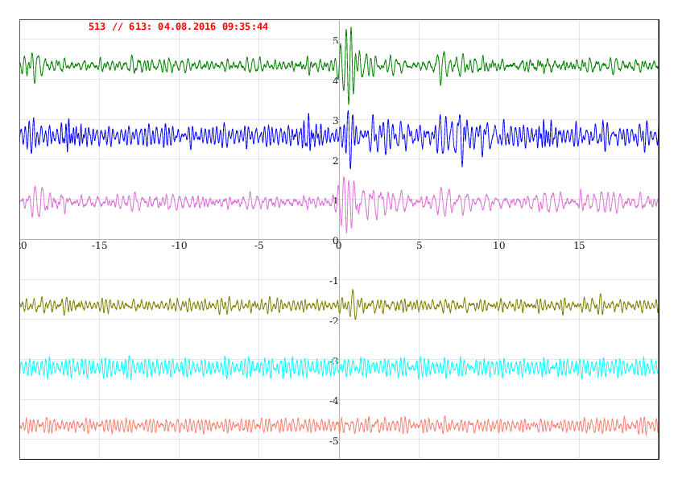
A SAMPLE RADIO-SIGNAL FROM EAS EVENTS

Slide 8
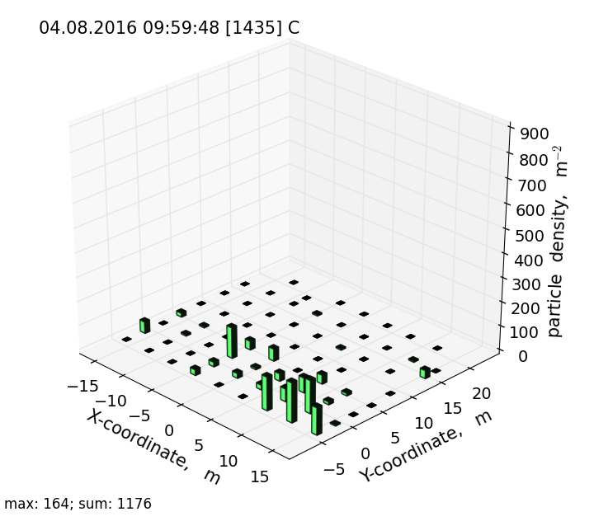
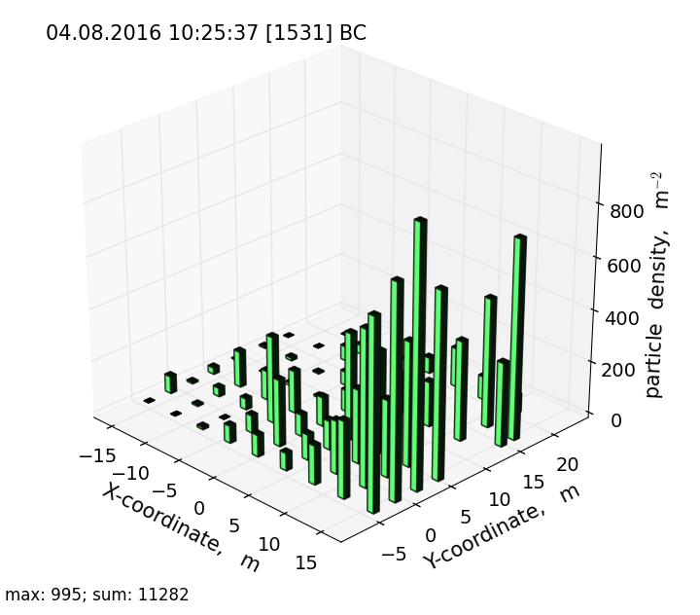
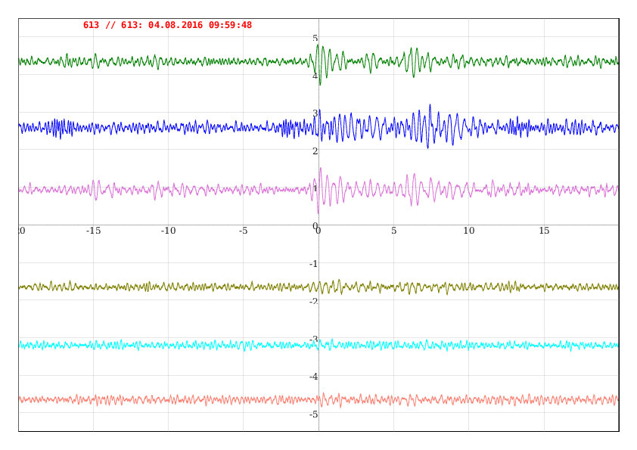
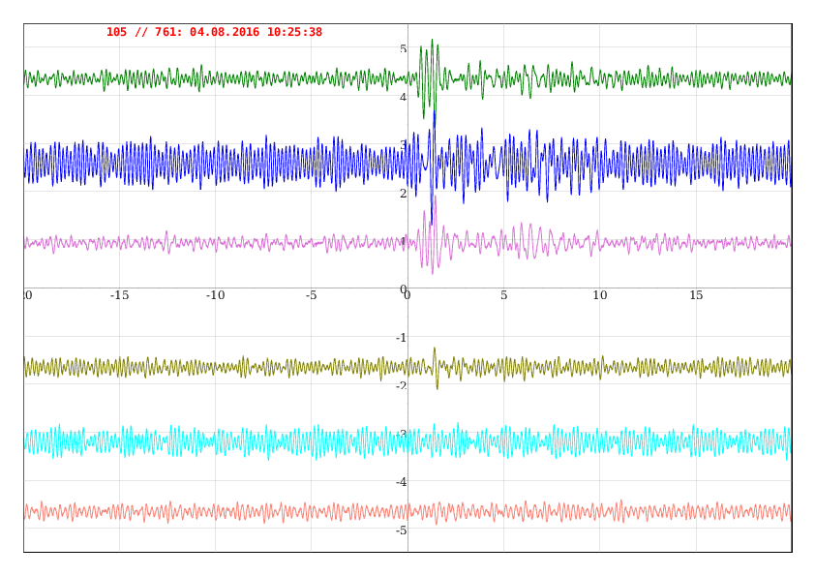
A SAMPLE RADIO-SIGNAL FROM EAS EVENTS

Slide 9
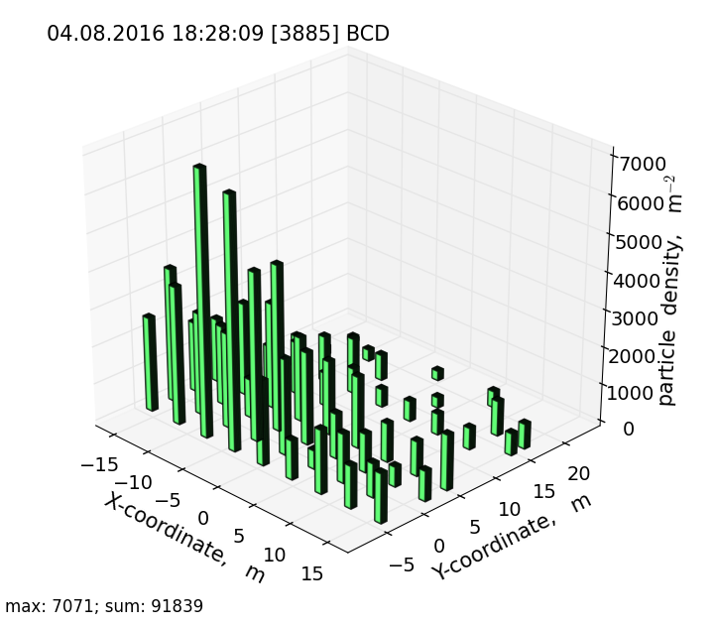
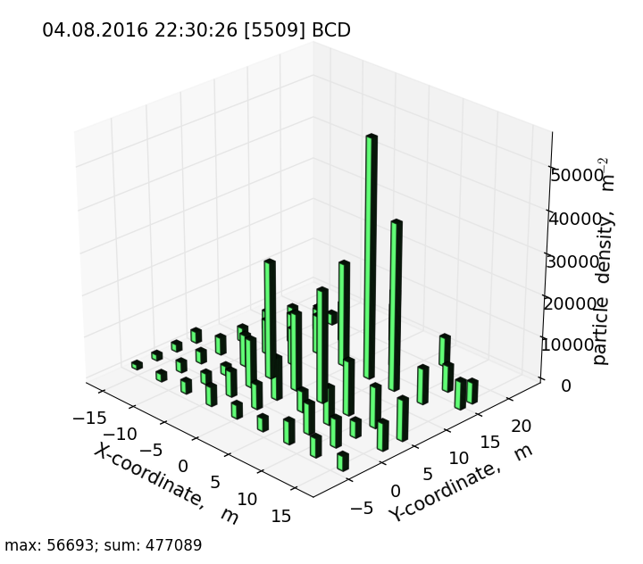
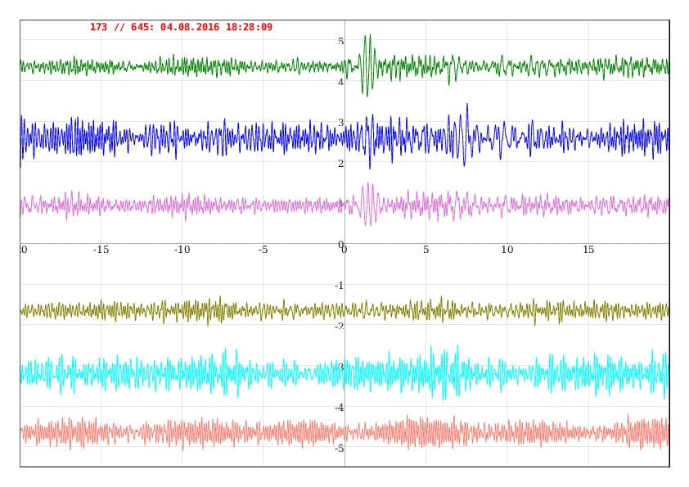
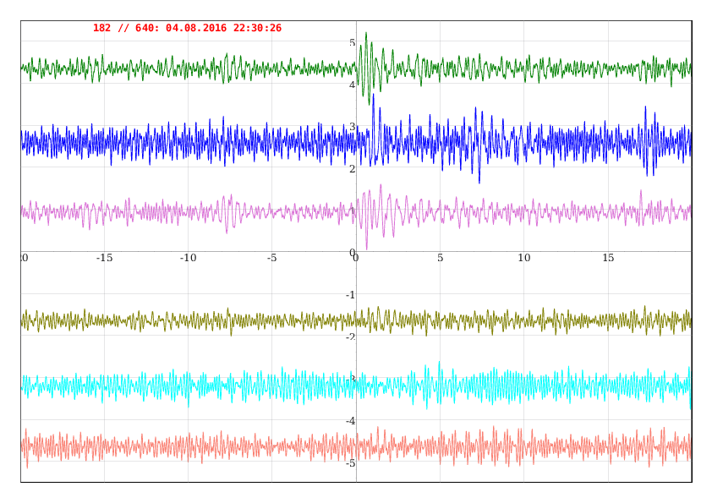
A SAMPLE RADIO-SIGNAL FROM EAS EVENTS

Slide 10
CONCLUSION
an EAS radio-emission registration system has been installed at the Tien Shan mountain cosmic ray station.
test measurements of radio signal made with the trigger from Tien Shan shower system demonstrate satisfactory operation of radio-detectors in real EAS events with primary energy
10¹⁵ -10¹⁶ eV.

